Slide 1
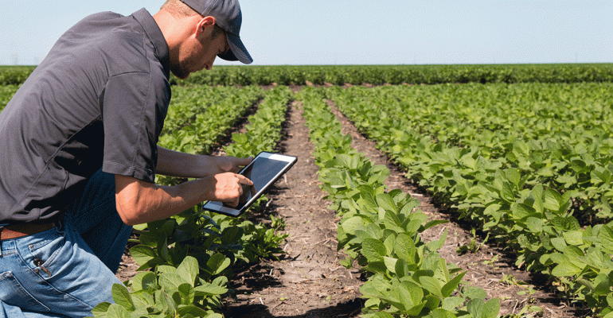
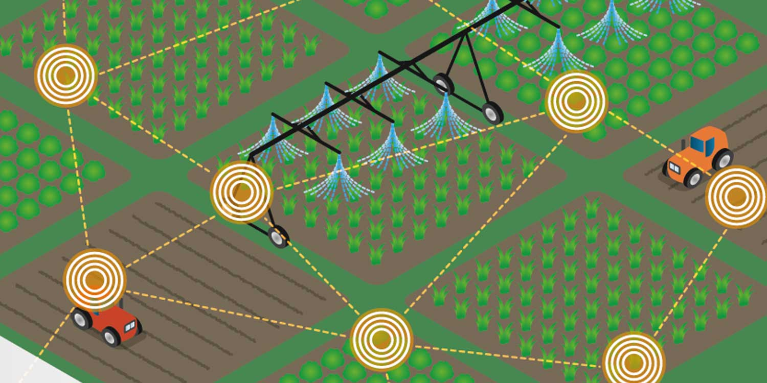
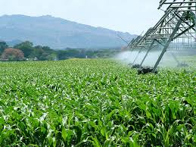
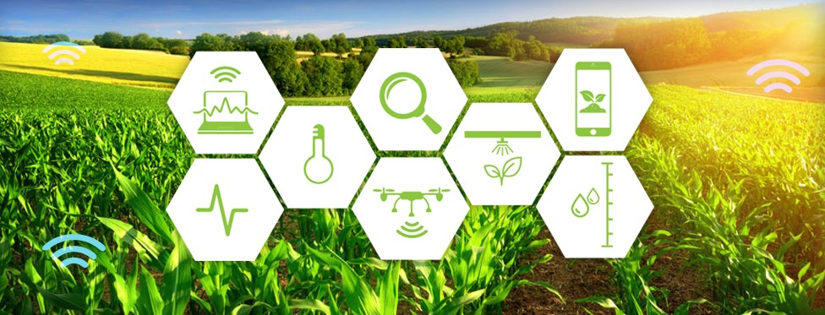
Using WeIO(IoT) and SmartUI
Smart Precision Agriculture

Slide 2
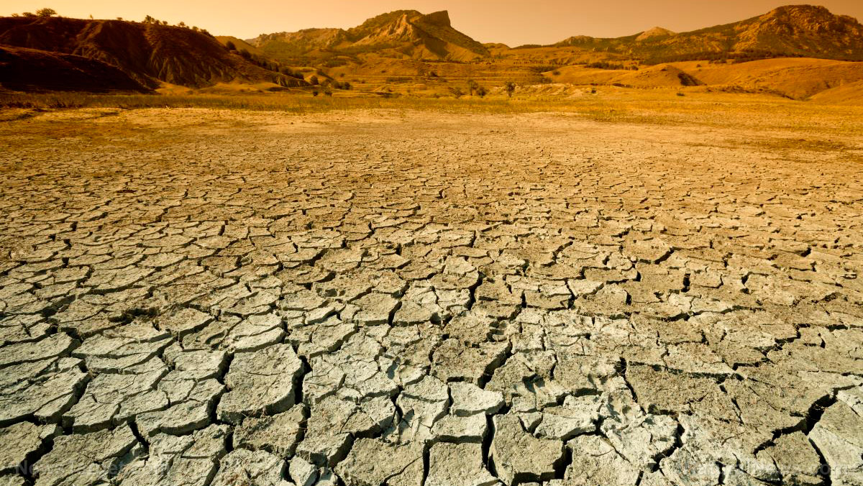
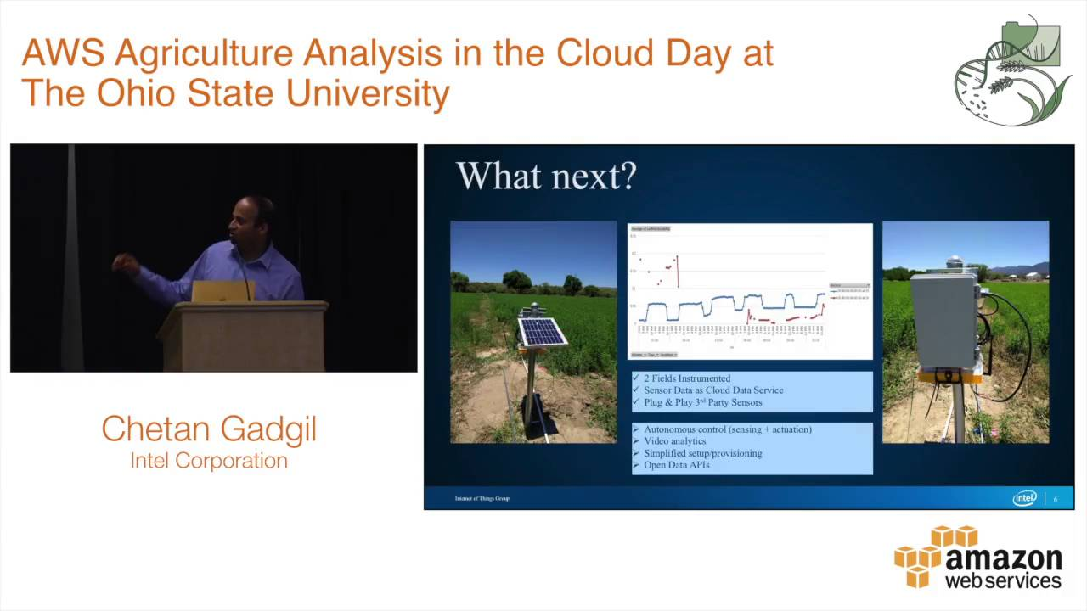
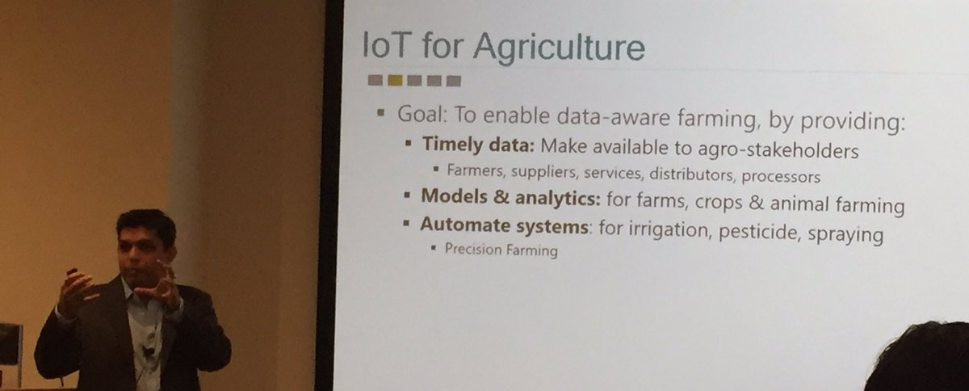
Reason for choosing this domain.
Advantages and innovation.
Intel's role in Agricultural development
– Chetan Gadgil
Microsoft – Precision agriculture
– Ranveer Chandra
So what are the drawbacks?
Let's get into the overview.

Slide 3
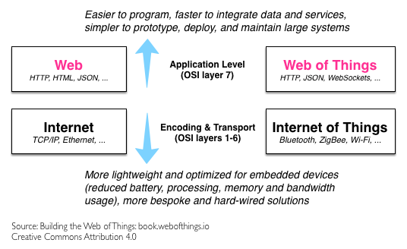
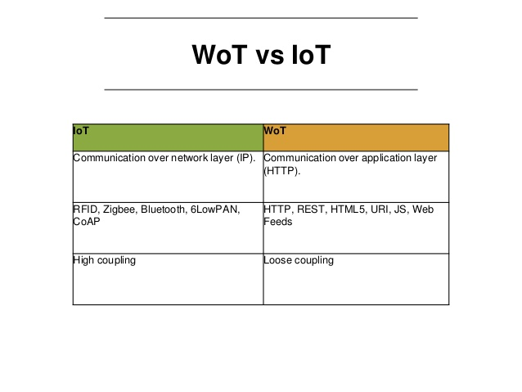
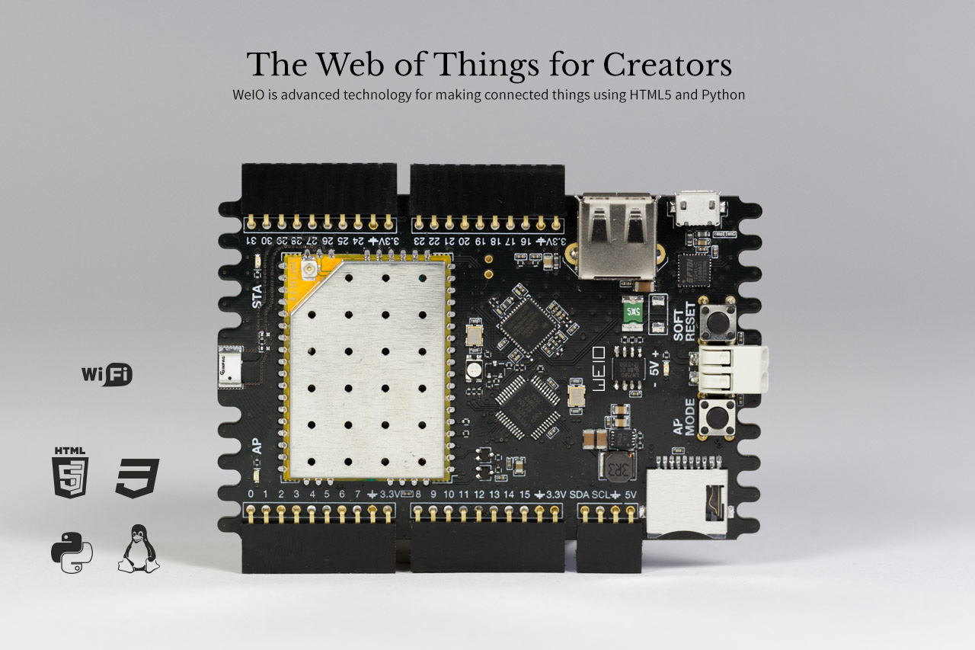
What WoT does here?
IoT vs WoT.
Building an application layer
- initiate actions from their mobile device
As easy as creating a website!!
WeIO for Web of Things.
What is WeIO?
- software and hardware platform.
How does it differ from Arduino?
- HTML 5, JavaScript, Python.

Slide 4
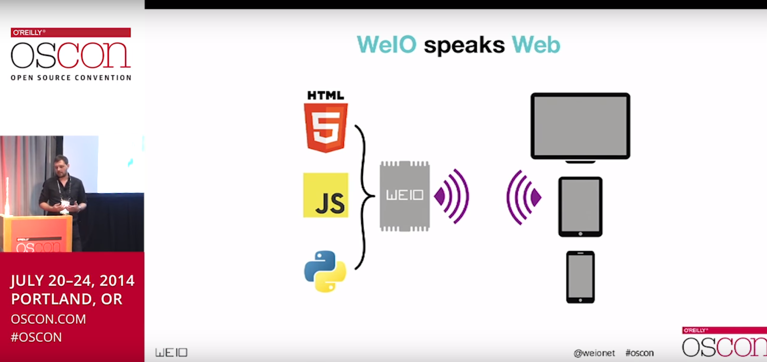
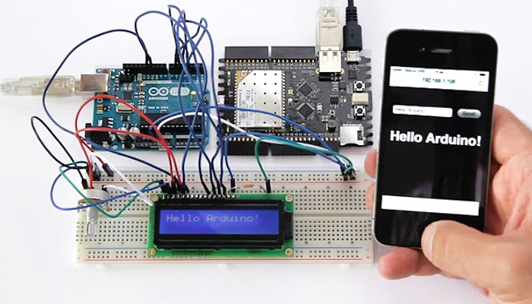
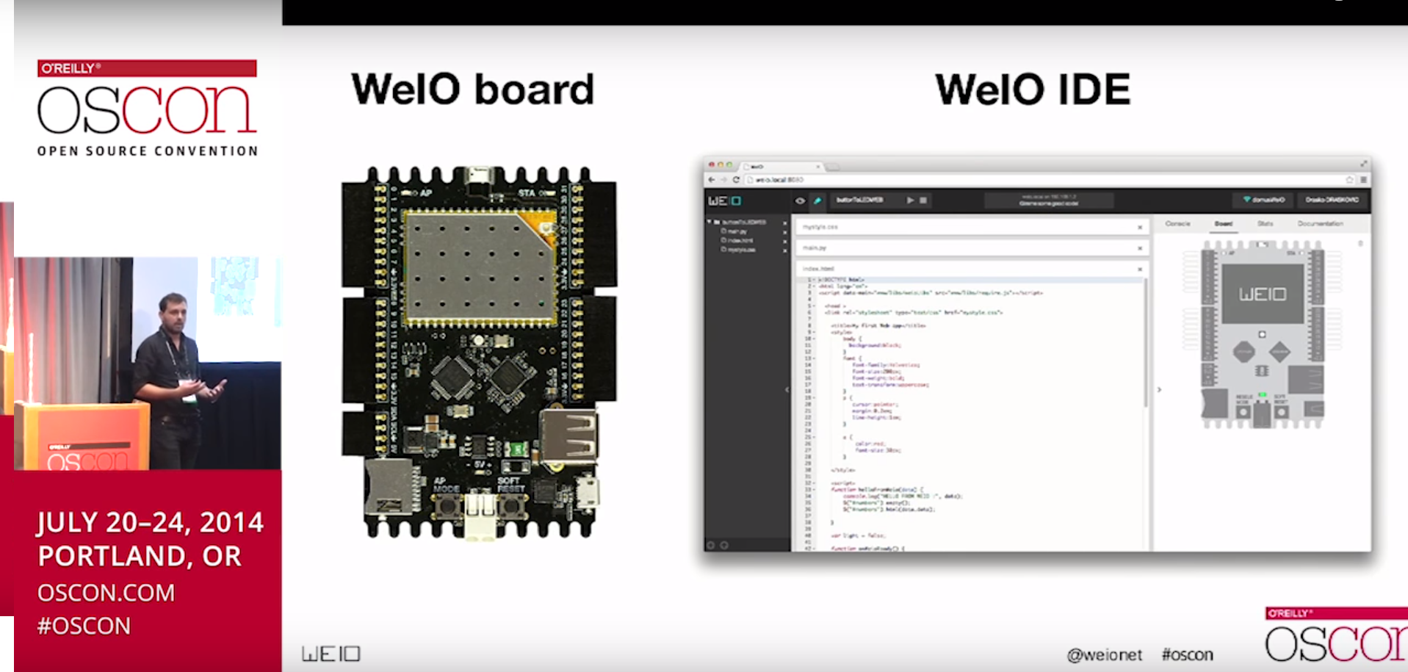
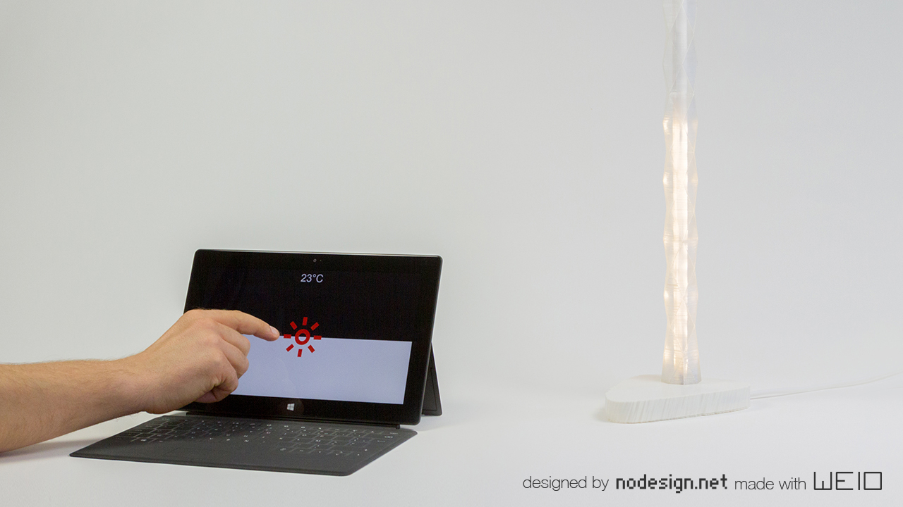

Slide 5
Idea Description
Gather data from the field via sensors and send it to sub stations situated in each part of the field.
The station sends the data wirelessly to a transceiver module named LoRa WAN.
LoRa transmits the data long range to the farmer who is far away from his field.
These data is uploaded to the cloud and sent to the WeIO module of the user (mobile application or browser).
User could easily trigger some actions and assess the condition of the field by a simple click from his mobile device (all these work in a simple way! WoT).
Increases the production by giving the farmer a greater insight of his field.

Slide 6
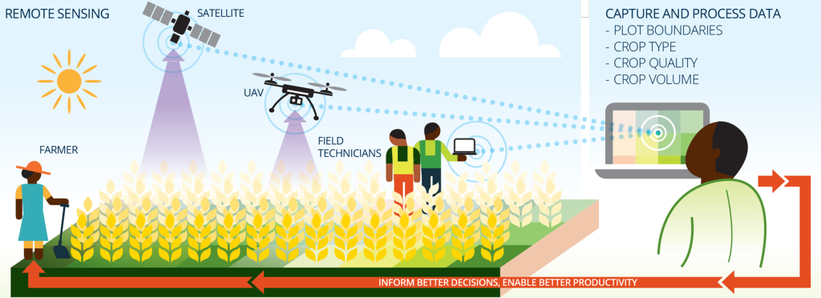
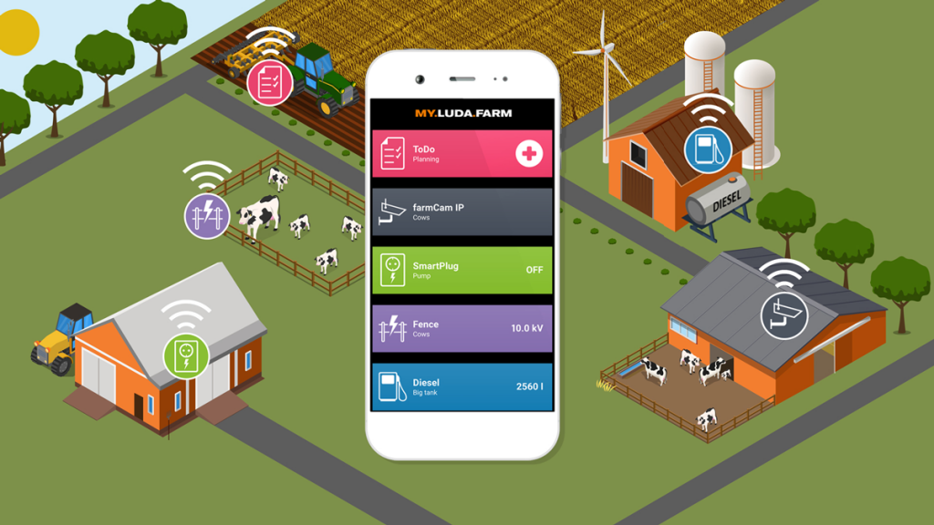
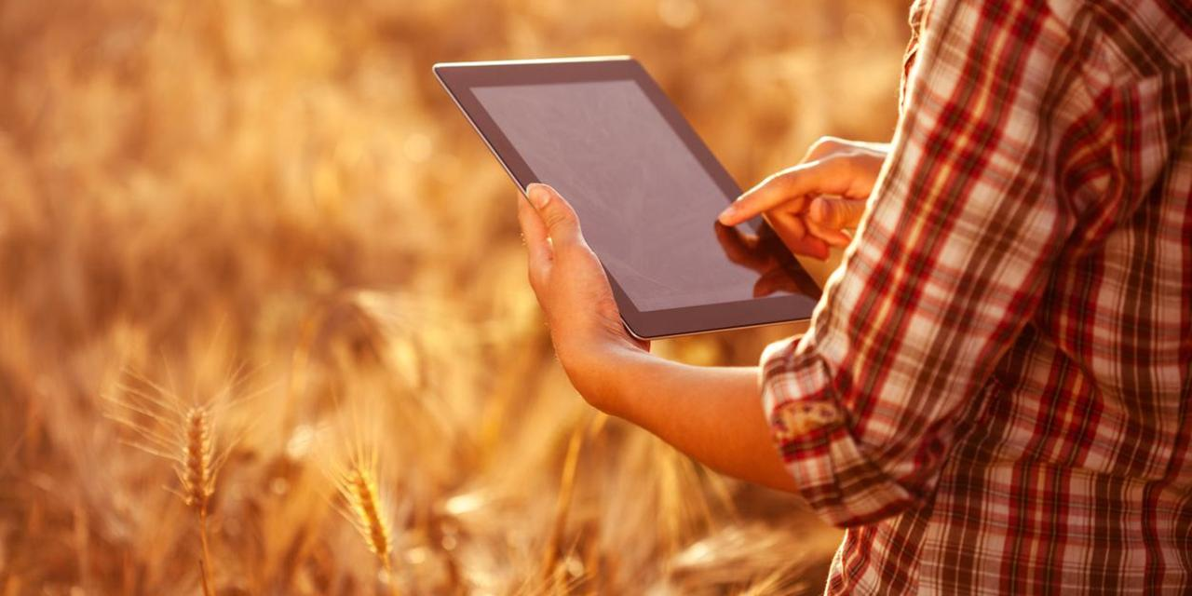

Slide 7
What are all the things that a farmer can do with this?
Monitor Agricultural parameters like temperature, sunlight, humidity, health of a crop, amount of fertilizers used, soil properties, etc.
Initiate actions like
- turn on the sprinkler when the temperature is high
- turn the motor on/off based on the water content in the soil
- by calculating pH levels, quality of the soil can be found
- monitor the field soil strength and create a heat map visualization
- control the location of tractor by tracing the paths using GPS
- generate predictive analysis from the data that has been collected
- the amount of fertilizer (composition) that he has used

Slide 8
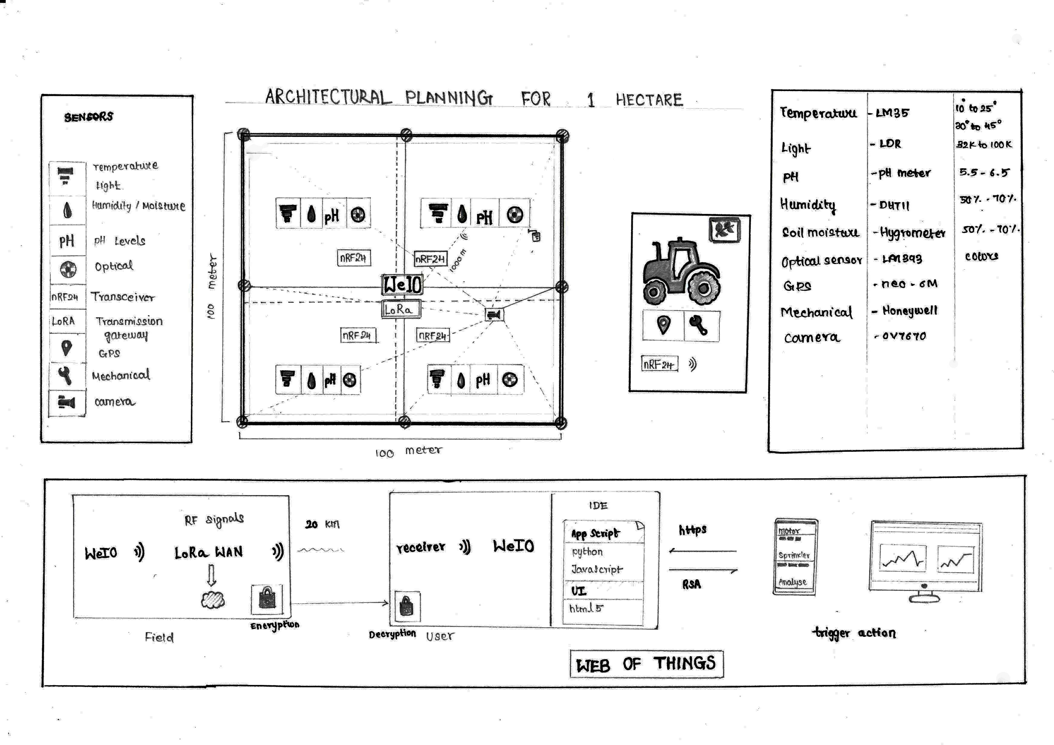
Let us see how it is done !

Slide 9
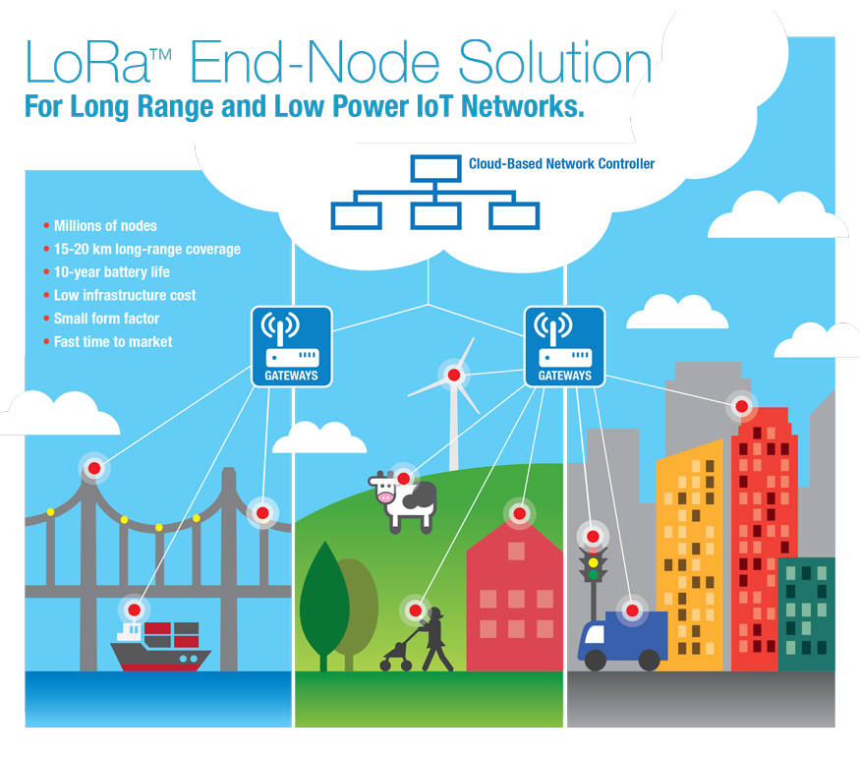
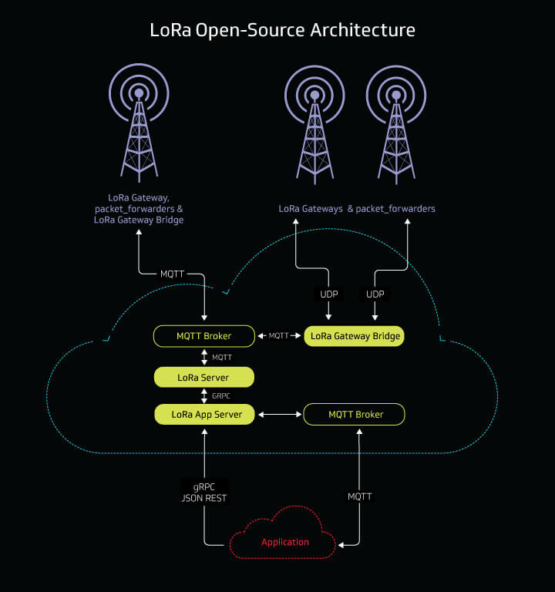
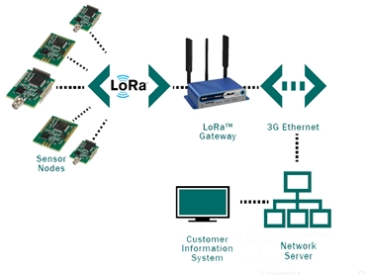

Slide 10
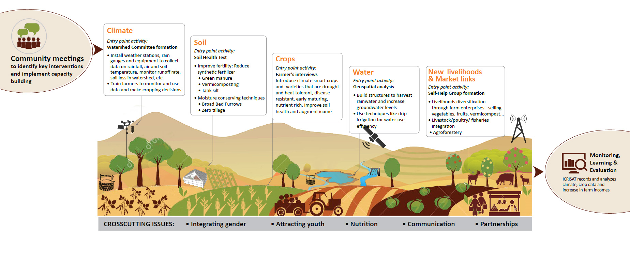
'' Where once upon a time, farmers needed to spend hours travelling around the farm to understand what was happening with their crops, today’s farmers are now able to keep an eye on things with the click of a mouse or the swipe of a finger.
Although it’s been in practice for more than 30 years, precision agriculture has gone into hyperdrive recently as faster and more affordable mobile technology has come online.
Precision agriculture generally refers to “site-specific” cropping, which involves varying inputs such as water and chemicals in isolated areas of a crop, as opposed to the entire field which in the past was the cheaper and more efficient option ''
BBC Future – Remote Control Farming

Slide 11
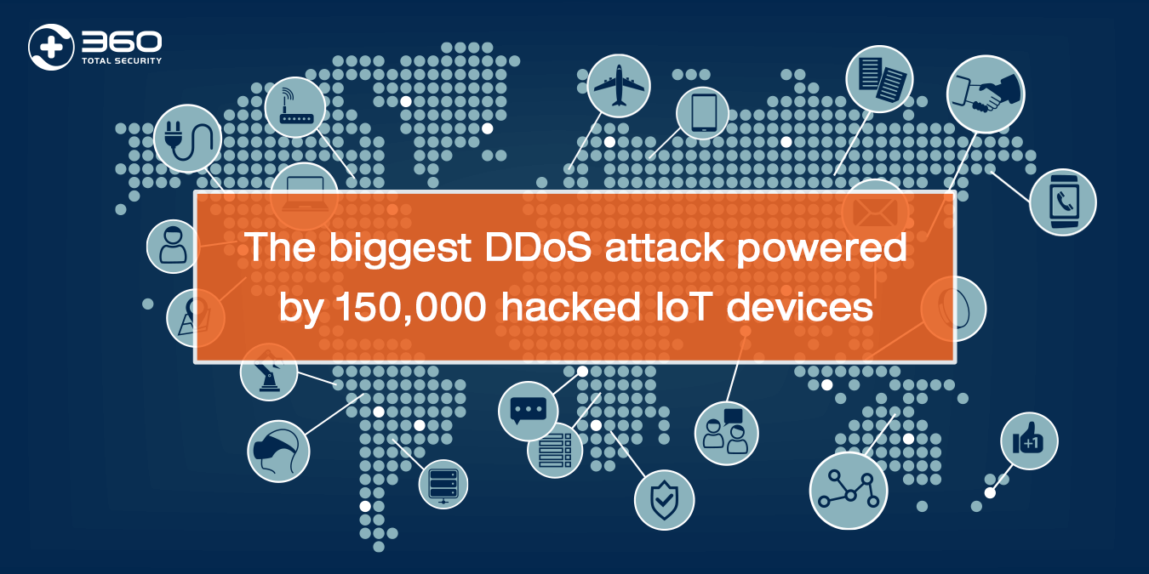
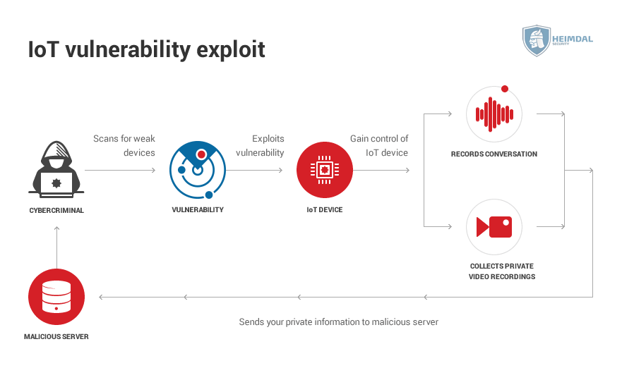
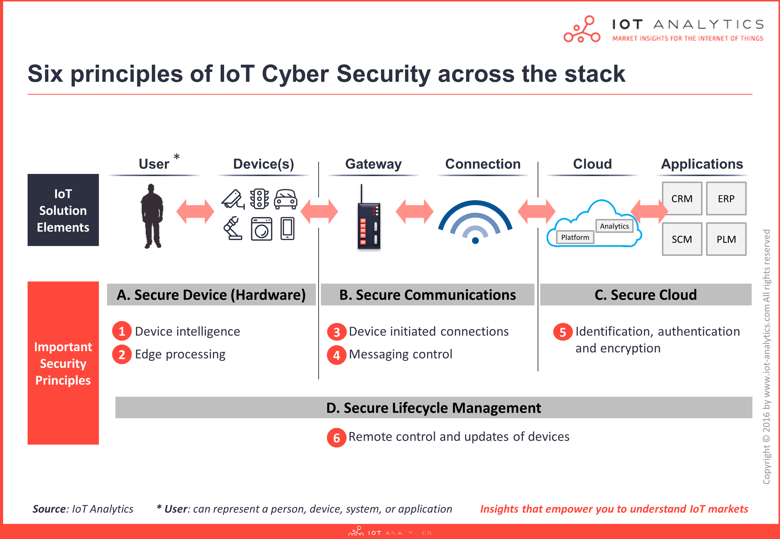
Ensuring safety and privacy
RSA conference 2017 – Dyn data attack
DDOS attack
Transport layer security
TLS handshake protocol
RSA cryptography
Agree on cryptography protocols
TLS+HTTP=HTTPS

Slide 12
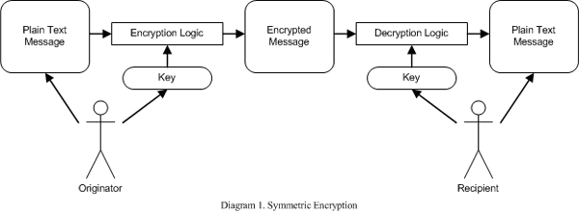
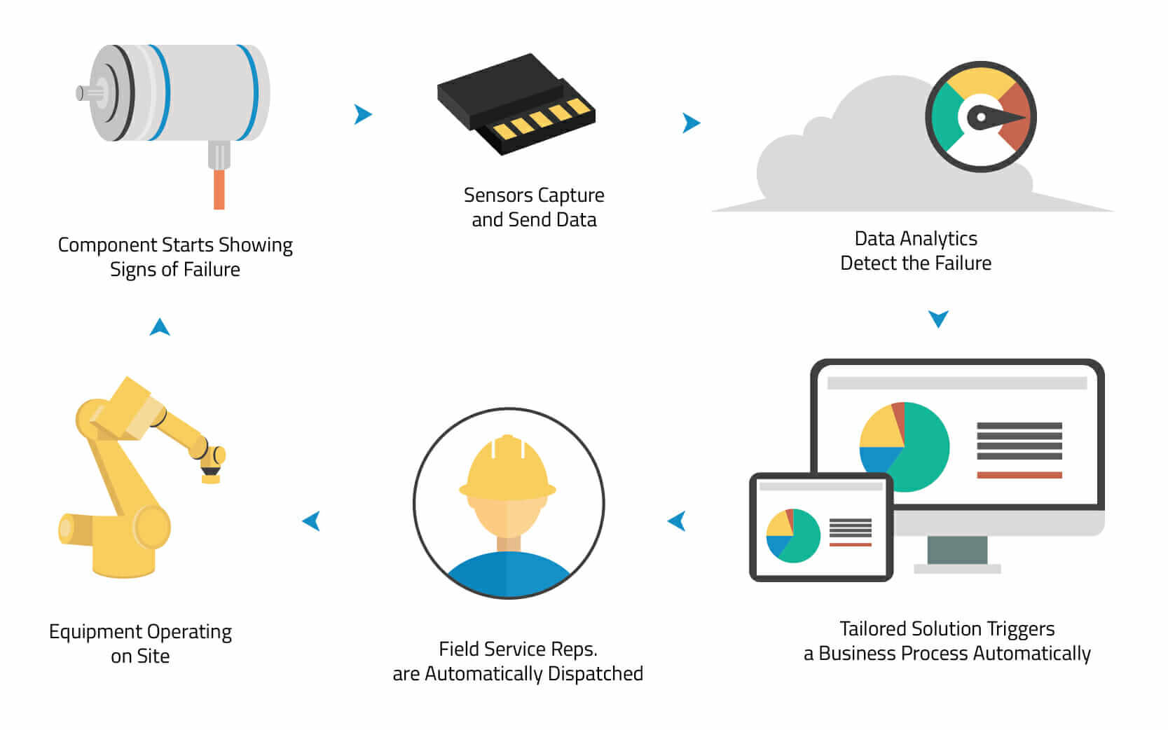
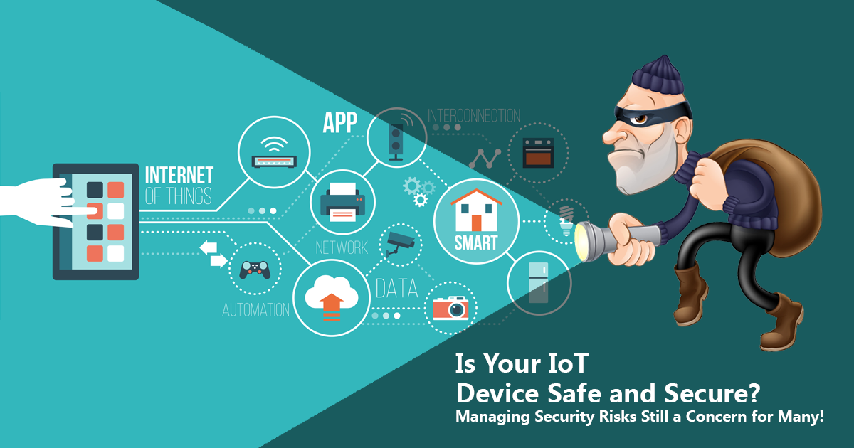

Slide 13
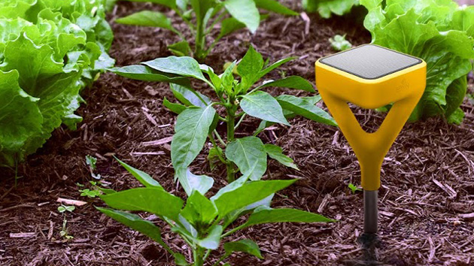
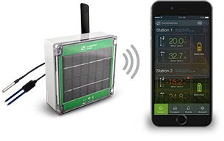
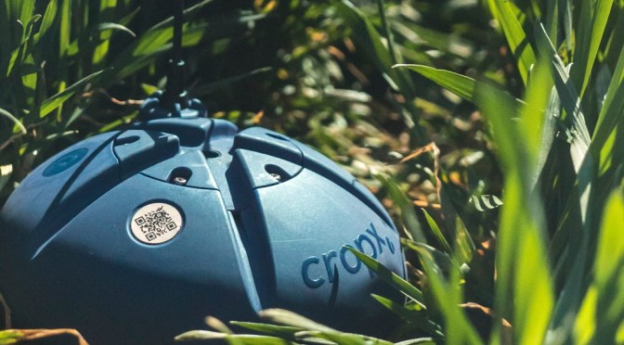
Existing Models and their drawbacks
Basic agricultural factors measuring equipments cost high
Some of the large scale farm monitorig IoT set ups in US costs
- Standard sensor solution (basic sensoring interface)(Rs. 1,17,063)
- Inversion measurement solution (basic sensors) (Rs. 1,00,395)
- CropX (cloud data)(Rs. 58,304/ year subscription)
An average farmer's salary is from 3,000 to 50,000 (depending upon seasonal factors) in India
Affordable and efficient.
Global market for IoT in agriculture
- 2016 | $2.66 billion
- 2021 | $4.47 billion
Sample run tests

Slide 14
How do we overcome these drawbacks?
The total rough estimated cost of the proposed model around 15,000 – 20,000
With all the monitoring factors and enabling the user to interact and trigger actions from his mobile device on the field even if the farmer is far away from the field.
Simple sensors with precise readings on an average sized farms.
Concentrating more on the basic things that our farmers face as an obstacle.
Compared to the available devices which are very expensive for a farmer to buy, our proposed system comes with an affordable amount which is even compensated by the increased production using smart farming within a year.
Testing the first model on few fields and proceeding with iterative development to increase efficiency and accuracy and also reducing the cost.
Analytics in thingspeak platform using matlab could produce predictive analysis which will be very beneficial to the farmer.

Slide 15
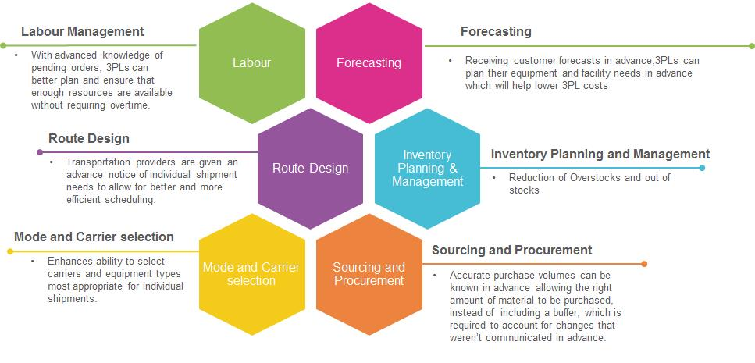
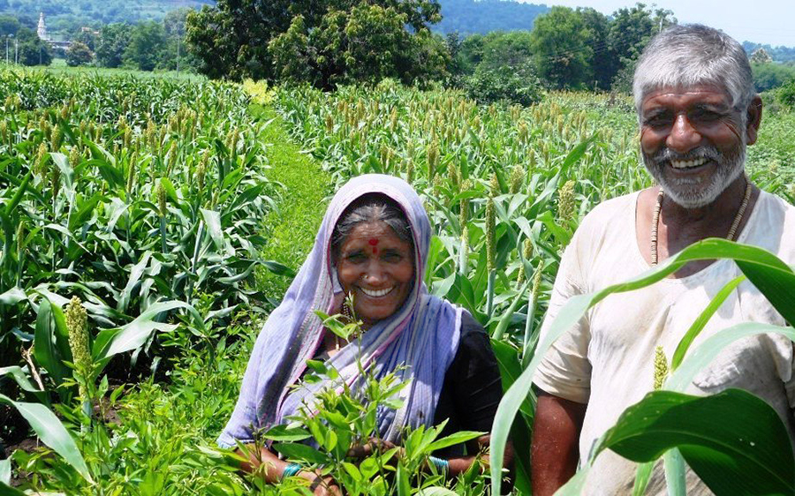
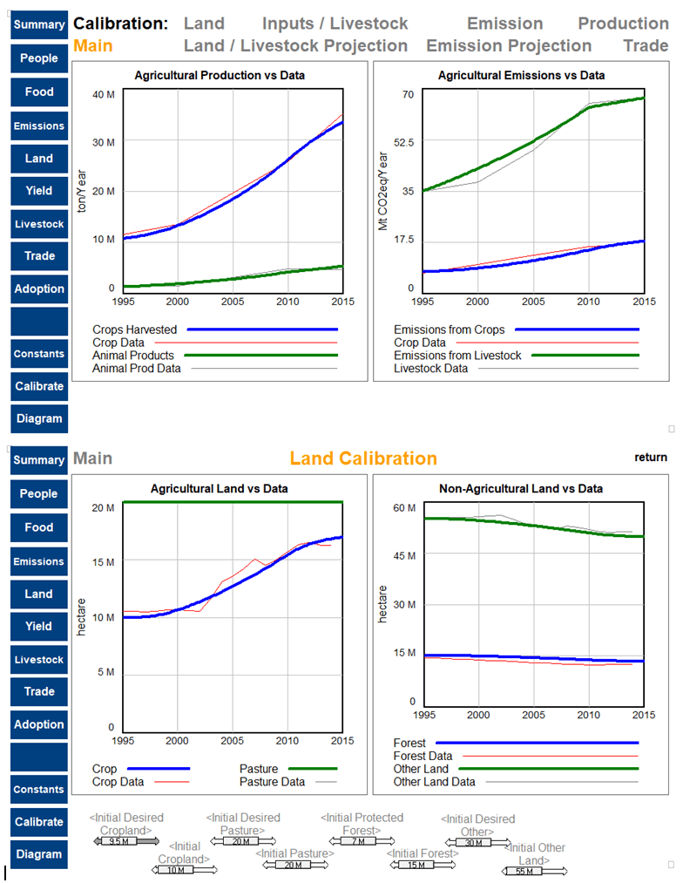
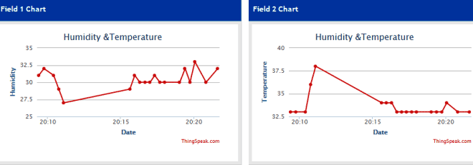

Slide 16
Software and Hardware requirements
WeIO IDE
Thingspeak
Cloud platform
Python, JS
Mobile Application
Browser
Temperature and humidity sensor(LM35/DHT11)
Light Sensor(LDR)
Ph Sensor(ph meter)
Soil moisture(Hygrometer)
Optical sensor(LM393)
GPS(Neo-6m)
Mechanical sensor(Honeywell)
Camera(ov7670)
NRF24 transceiver
LoRa WAN

Slide 17
References
https://github.com/nodesign/weio
https://webofthings.org/
https://www.link-labs.com/blog/iot-agriculture
https://www.mouser.in/applications/smart-agriculture-sensors/
https://www.indiegogo.com/projects/weio-platform-for-web-of-things#/
https://www.techrepublic.com/article/ddos-attacks-increased-91-in-2017-thanks-to-iot/
http://www.fao.org/climate-smart-agriculture/en/

Slide 18
Thank You

